Slide 1

Analysis of Privacy Protections in Fitness Tracking Social Networks -or-
You can run, but can you hide?
Wajih Ul Hassan*, Saad Hussain*, Adam Bates
27th USENIX Security Symposium
16 August 2018
.
*Joint first authors

Slide 2





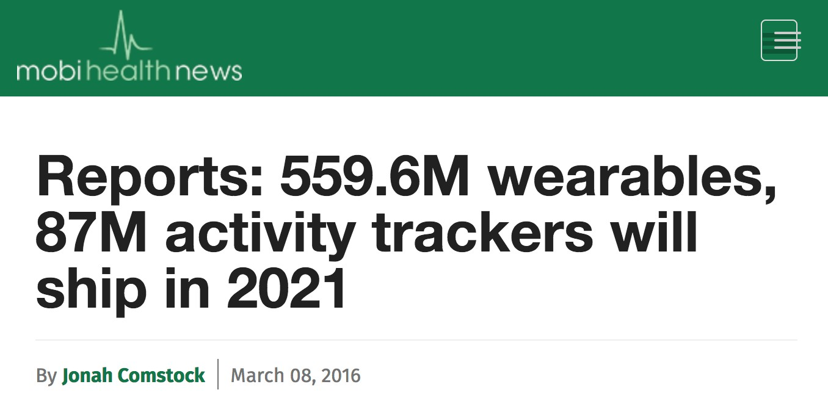


Self-Tracking Market
2
Notes:
目前：三分之一的人们都会跟踪自己的健康数据， 跟踪健康数据的产业创造了十亿的增长
未来发展前景：482亿市场份额 5.6亿穿戴设备 8700万追踪器将上市
说明现实意义

Slide 3














Fitness Tracking Ecosystem
Taken from Strava page on google playstore
3

Slide 4



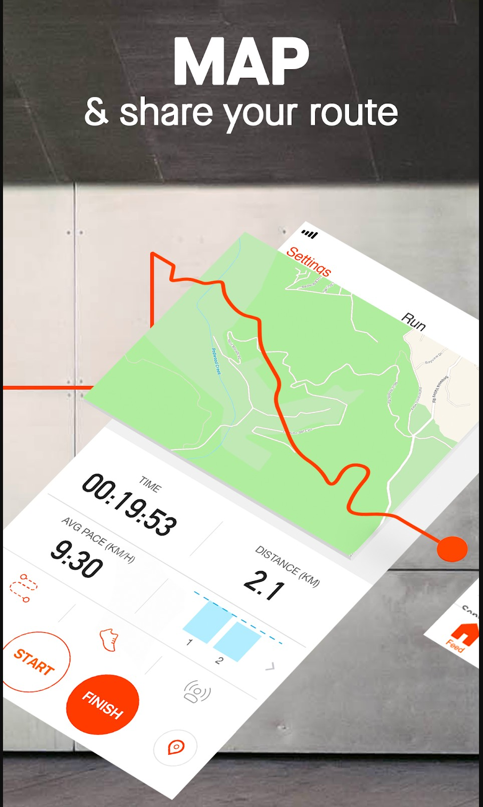
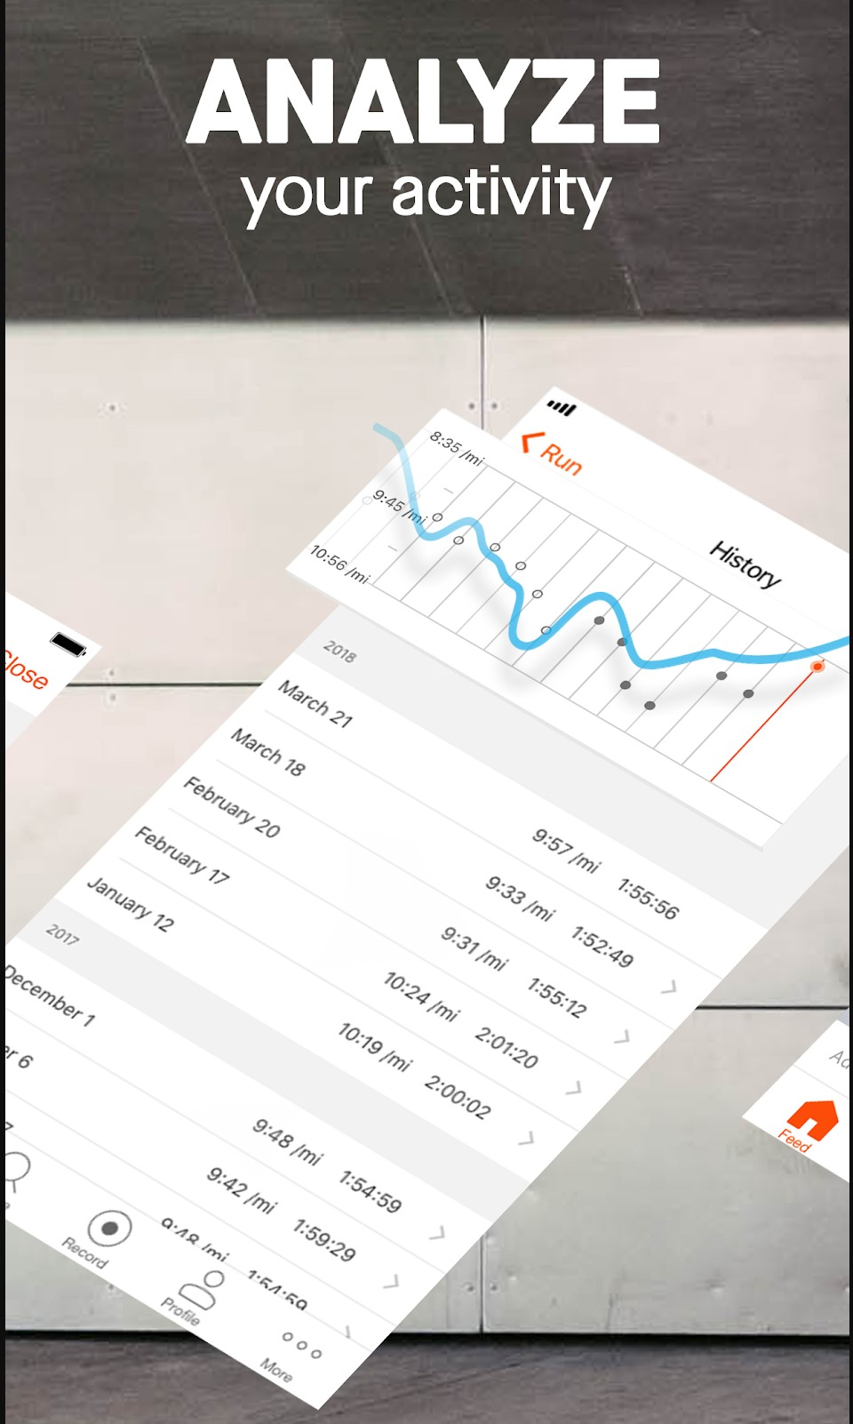

Fitness Tracking Ecosystem
Taken from Strava page on google playstore
3

Slide 5
Privacy Concerns
People usually run from sensitive locations (e.g., home)
Broadcasting routes to public has privacy concerns
4

Slide 6

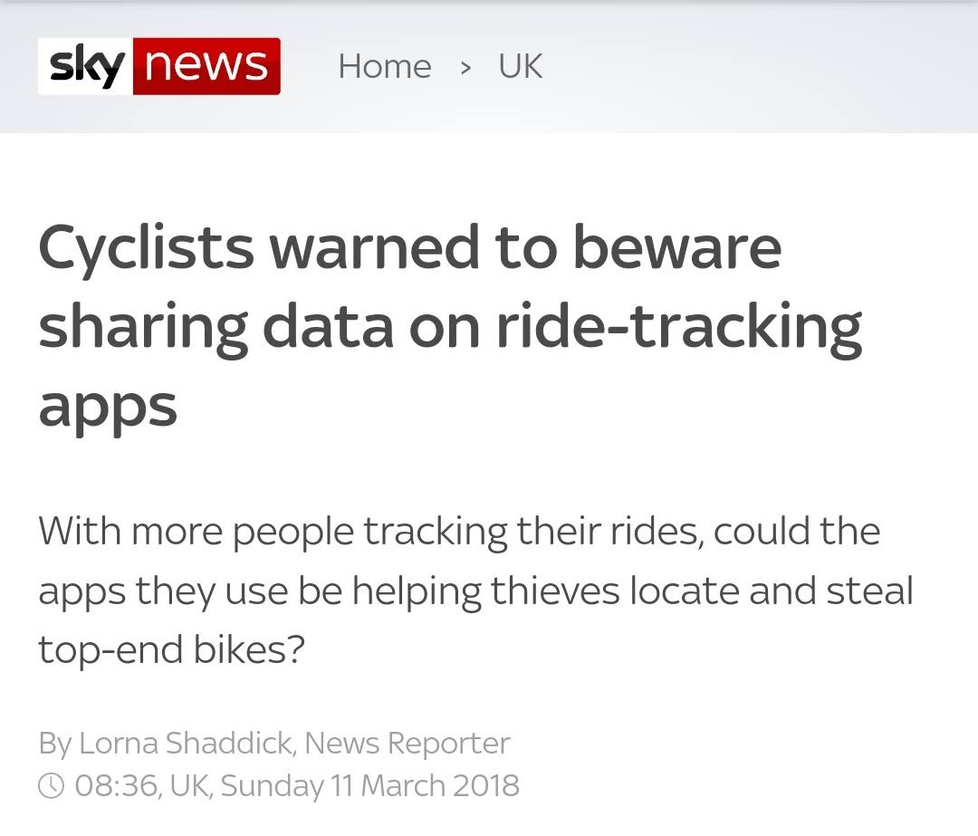

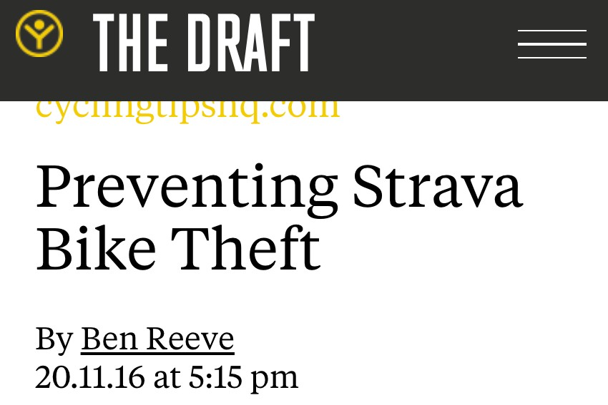


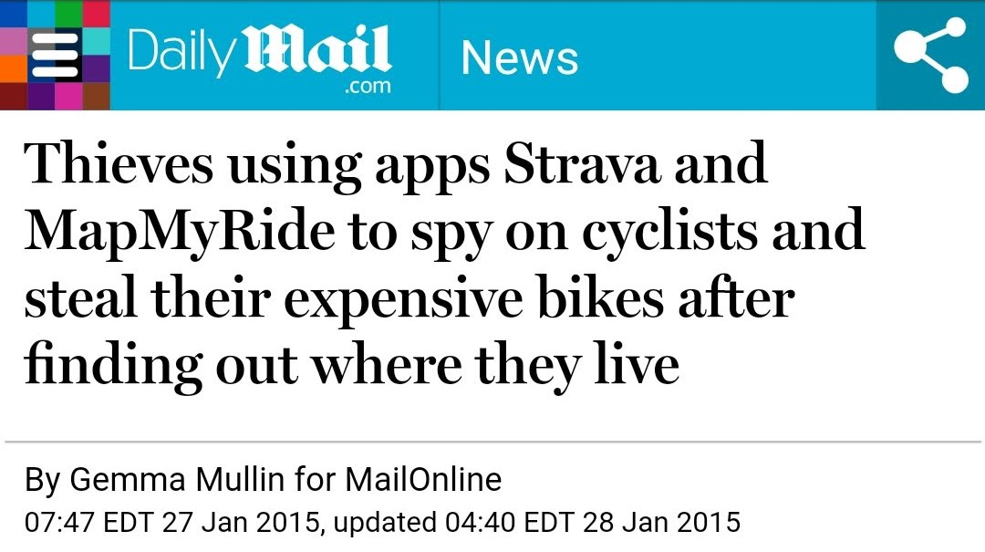
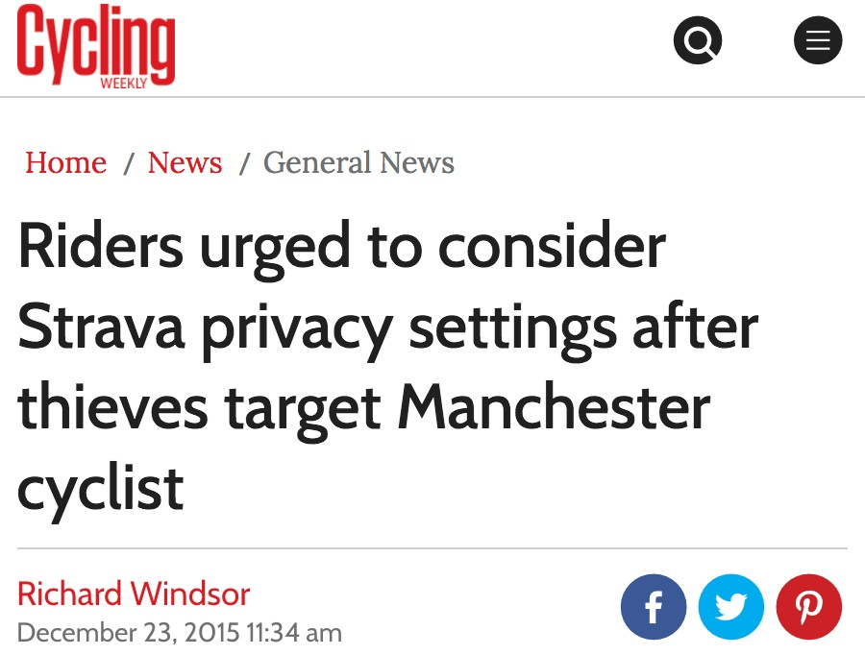

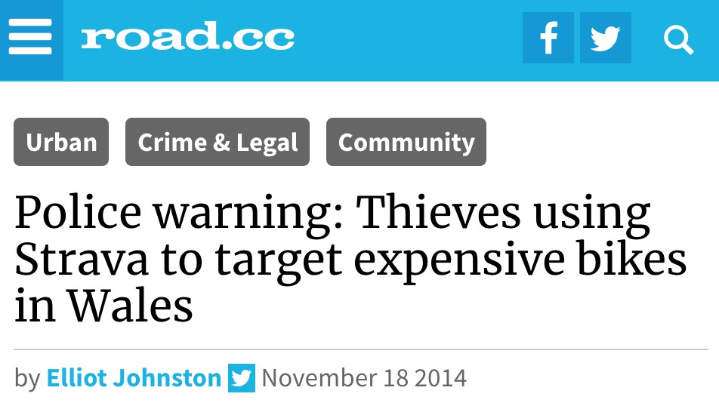

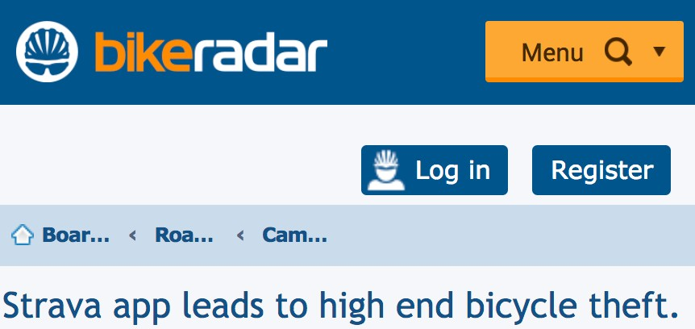

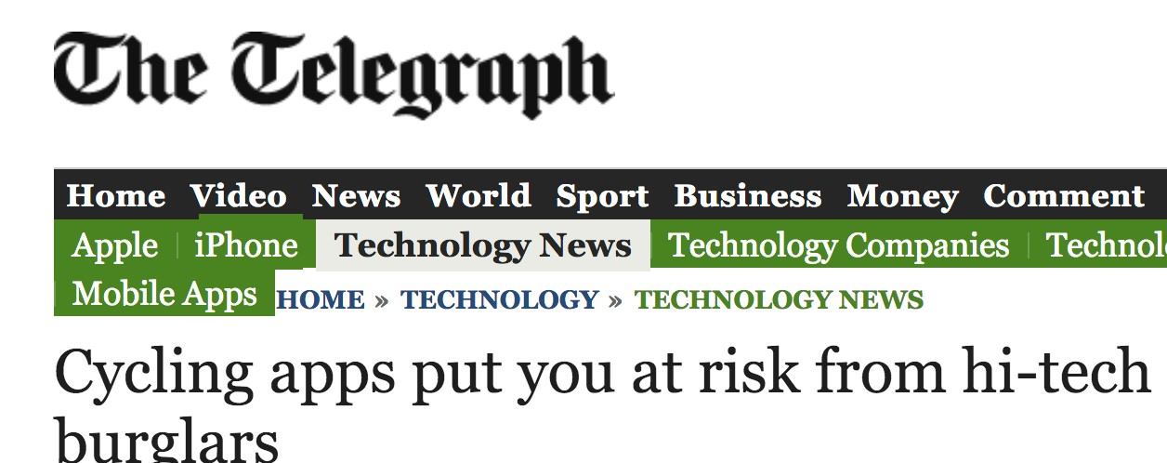
Privacy Concerns
People usually run from sensitive locations (e.g., home)
Broadcasting routes to public has privacy concerns
4

Slide 7

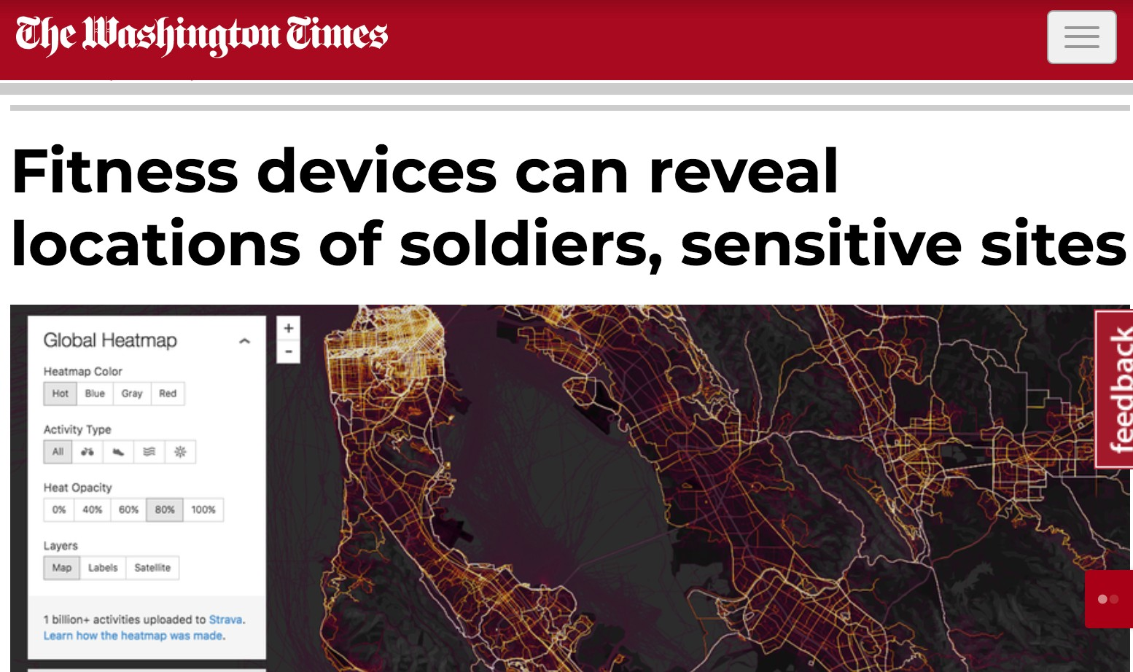

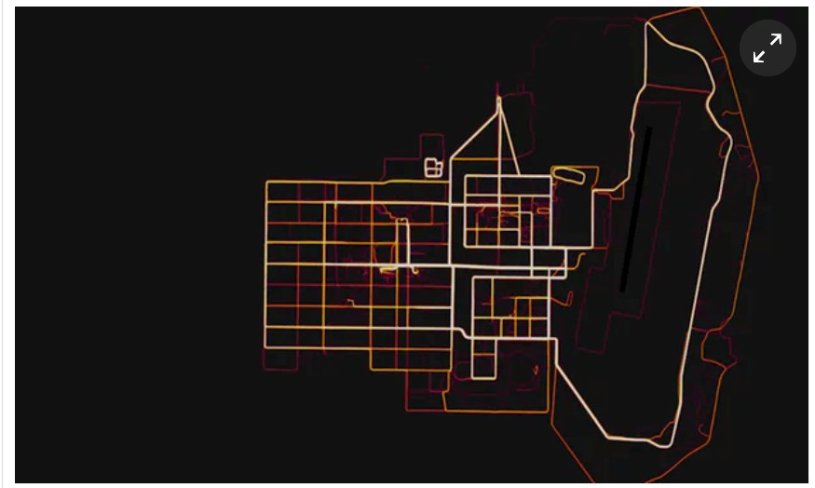
Privacy Concerns
People usually run from sensitive locations (e.g., home)
Broadcasting routes to public has privacy concerns
A military base in Helmand Province, Afghanistan with route taken by joggers
5

Slide 8
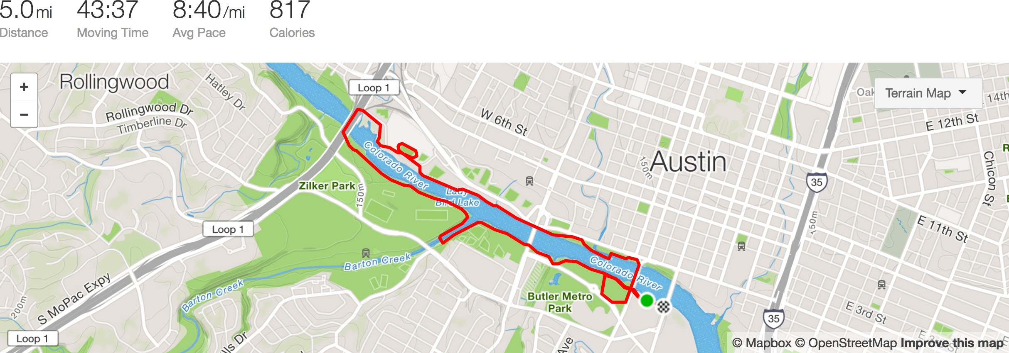


Strava Run Activity
USENIX Security 2016
Before applying Endpoint Privacy Zone
6

Slide 9
Endpoint Privacy Zone (EPZ)
Strava allows users to hide sensitive endpoints using privacy zones
Endpoint privacy zone is a fixed radius circular area
It hides the portion of activity that starts or ends in the circular area
7

Slide 10

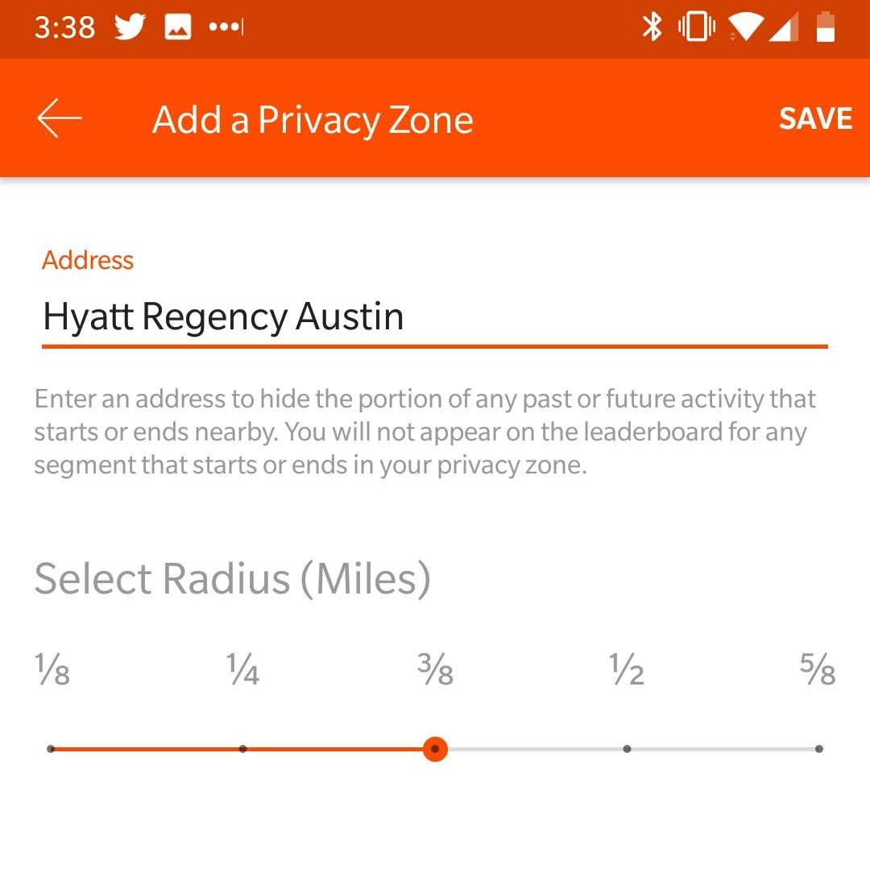



Endpoint Privacy Zone (EPZ)
Strava allows users to hide sensitive endpoints using privacy zones
Endpoint privacy zone is a fixed radius circular area
It hides the portion of activity that starts or ends in the circular area
7

Slide 11
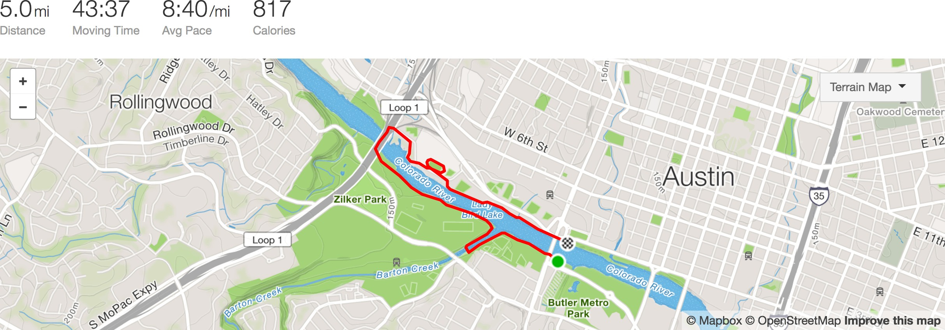
What Other People See
USENIX Security 2016
After applying Endpoint Privacy Zone
8

Slide 12
What happened behind the curtain
9

Slide 13
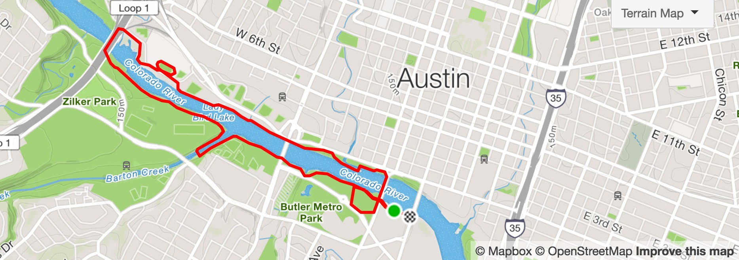
EndPoint Privacy Zone (EPZ)
10

Slide 14
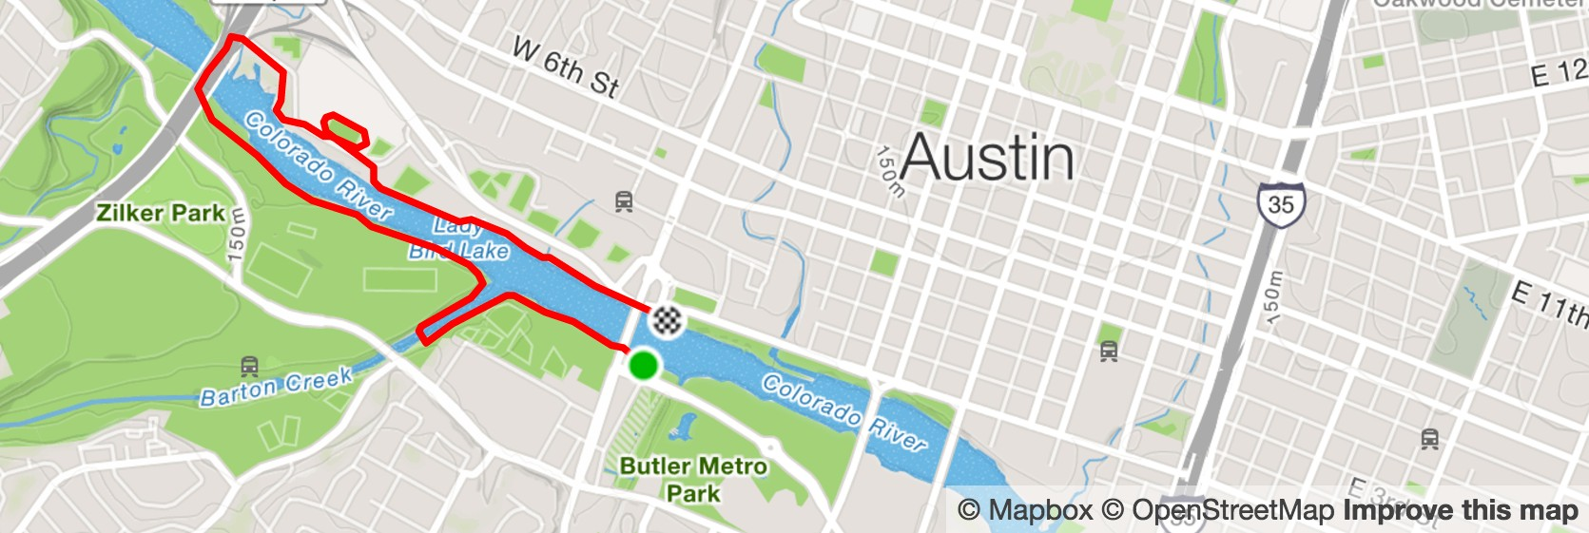



EndPoint Privacy Zone (EPZ)
Generate a EPZ at user specified center
Center is the sensitive location
Remove all the activity GPS points lying inside circle
10

Slide 15

Guessing EPZ Center
11

Slide 16





Guessing EPZ Center
Given two points generate circles that passes through those points
11

Slide 17

Guessing EPZ Center
Given two points generate circles that passes through those points
11

Slide 18

Guessing EPZ Center
Given two points generate circles that passes through those points
11

Slide 19

Guessing EPZ Center
Given two points generate circles that passes through those points
With three points you will find right EPZ
11

Slide 20
Is it that Simple?
12

Slide 21
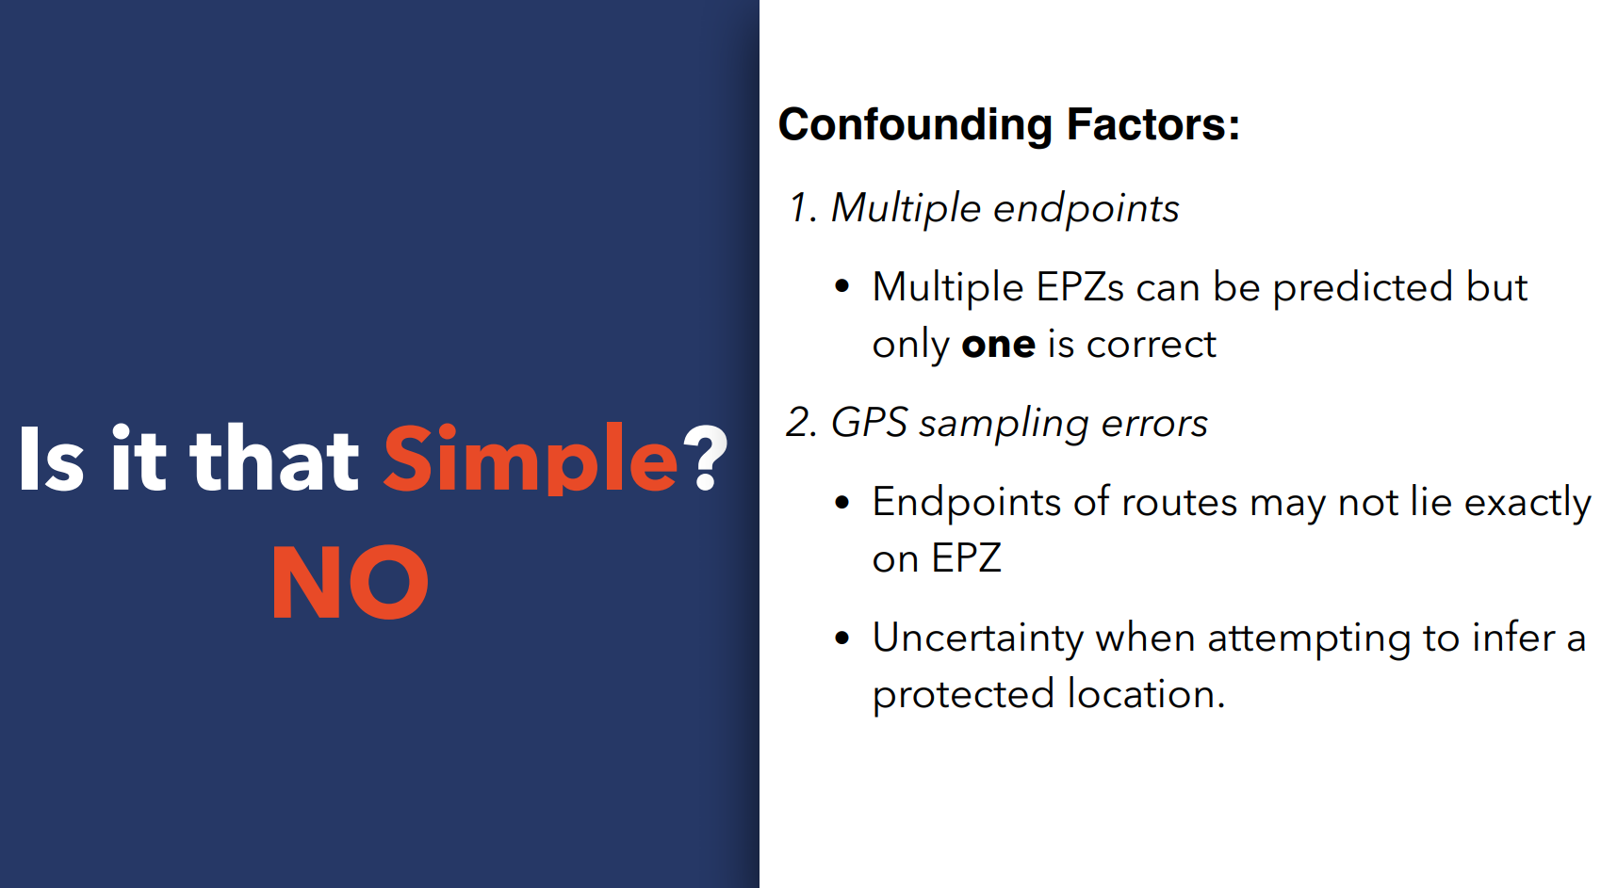
12

Slide 22
You can run, but can you hide?
13

Slide 23
You can run, but can you hide?
Collected activity dataset from strava.com
Designed robust algorithm to search EPZ circles
Validated our algorithm on unprotected activities
Ran an attack on protected activities
Designed mitigation strategies
14

Slide 24
Dataset
Scraped May 2016 activity dataset from strava.com
Collected GPS coordinates, activity type, duration, distance, athlete ID etc.
15

Slide 25


Dataset
Scraped May 2016 activity dataset from strava.com
Collected GPS coordinates, activity type, duration, distance, athlete ID etc.
Ride 65%
21
Million Activities
Run 31%
Walk
2%
Others
2%
15

Slide 26




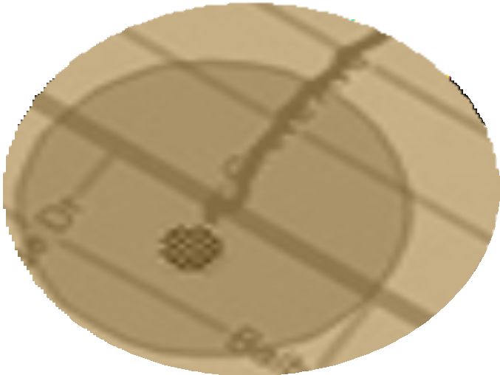


Dataset
Scraped May 2016 activity dataset from strava.com
Collected GPS coordinates, activity type, duration, distance, athlete ID etc.
Ride 65%
21
Million Activities
18.5M Non-EPZ
Activities
2.3M EPZ
Activities
3M
Athletes
241
Countries
Run 31%
Walk
2%
Others
2%
15

Slide 27
EPZsearch
Least Square Circle Fit (LSF) algorithm
But it does not fit our needs:
Considers all the endpoints
We don’t know which endpoints associated with EPZ
Wildly inaccurate results if one endpoint is wrong
Considers all possible radii while only finite are allowed by services
Does not cater jitter GPS coordinates
Slow

Slide 28
Our EPZ Search Algorithm
Generate candidate EPZs as follows:
For each pair of activities, perform pairwise inspection of each possible combination of endpoints
17

Slide 29
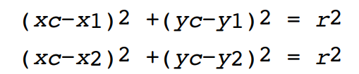
Our EPZ Search Algorithm
Generate candidate EPZs as follows:
For each pair of activities, perform pairwise inspection of each possible combination of endpoints
For each pair of endpoints (x1,y1),(x2,y2), solve the simultaneous equations
where (xc,yc)is center and r is possible radius
Each solution of simultaneous equation is one candidate EPZ
17

Slide 30
Our EPZ Search Algorithm
We use consensus procedure among candidate EPZs to give confidence scores to each EPZ
Confidence score is the number of activity start/end points that independently agree on the location of the EPZ
18

Slide 31
Our EPZ Search Algorithm
We use consensus procedure among candidate EPZs to give confidence scores to each EPZ
Confidence score is the number of activity start/end points that independently agree on the location of the EPZ
To accounts for jitters in GPS coordinates we use parametrized threshold
We considers two EPZs as same if the distance between the centers is less than or equal to the specified threshold
18

Slide 32
Our EPZ Search Algorithm
Finally, rule out candidate EPZs which do not make sense
Candidate EPZs intersecting other portion of routes
Candidates EPZs with less than certain confidence score
19

Slide 33
Our EPZ Search Algorithm
Finally, rule out candidate EPZs which do not make sense
Candidate EPZs intersecting other portion of routes
Candidates EPZs with less than certain confidence score
In end, our algorithm predicts one EPZ with highest confidence score
We use training run to automatically find best threshold for a specific service
19

Slide 34
Attack Validation
•
Test EPZ search algorithm
•
Created synthetic EPZ with radius
0.25 miles on unprotected activities so that we know exact center
•
Use our algorithm to predict the center
20

Slide 35
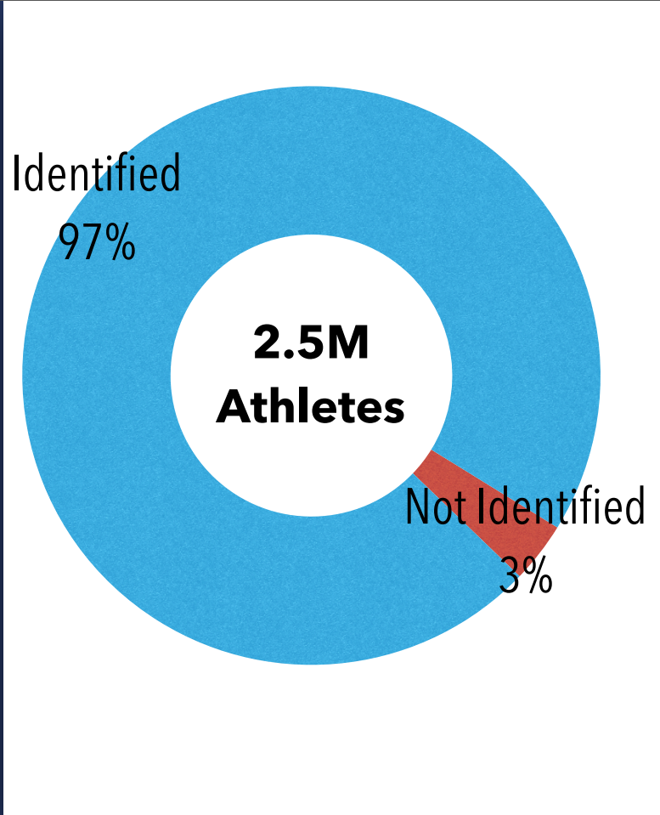
Attack Validation
•
Test EPZ search algorithm
•
Created synthetic EPZ with radius
0.25 miles on unprotected activities so that we know exact center
•
Use our algorithm to predict the center
20

Slide 36

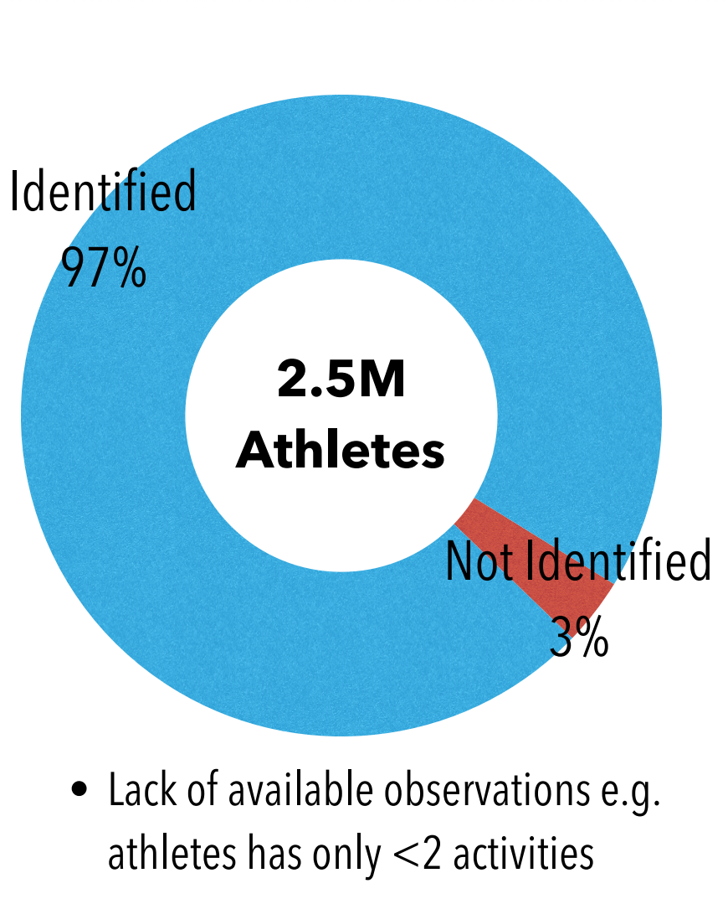
Attack Validation
•
Test EPZ search algorithm
•
Created synthetic EPZ with radius
0.25 miles on unprotected activities so that we know exact center
•
Use our algorithm to predict the center
20

Slide 37
Attack Evaluation
•
After attack validation we identified actual protected location
•
Deployed our search algorithm on protected activities
21

Slide 38

Attack Evaluation
•
After attack validation we identified actual protected location
•
Deployed our search algorithm on protected activities
21

Slide 39
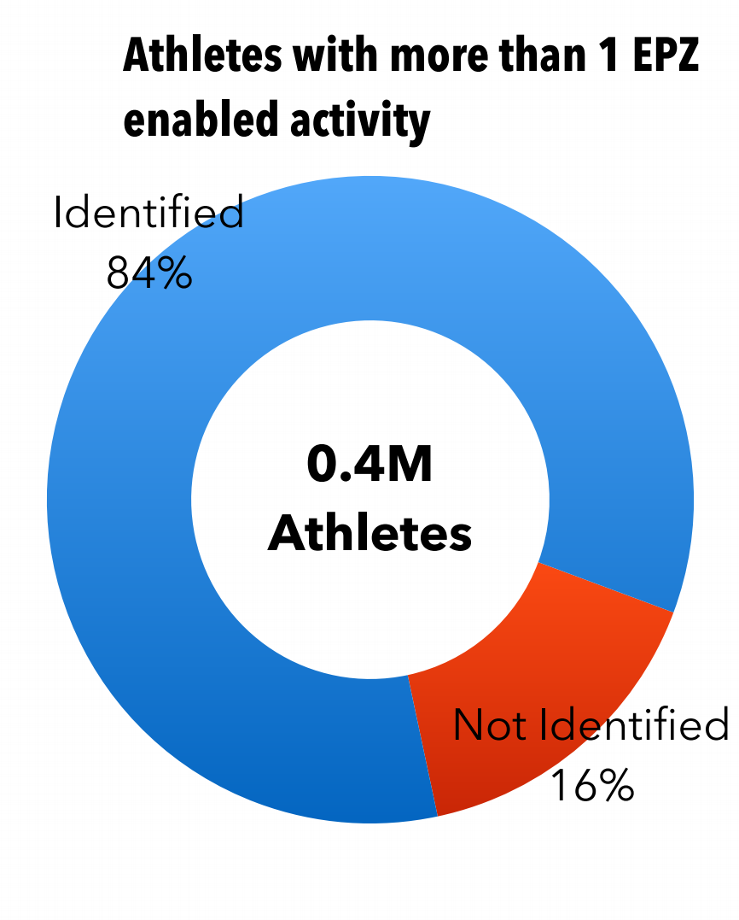
Attack Evaluation
•
After attack validation we identified actual protected location
•
Deployed our search algorithm on protected activities
21

Slide 40
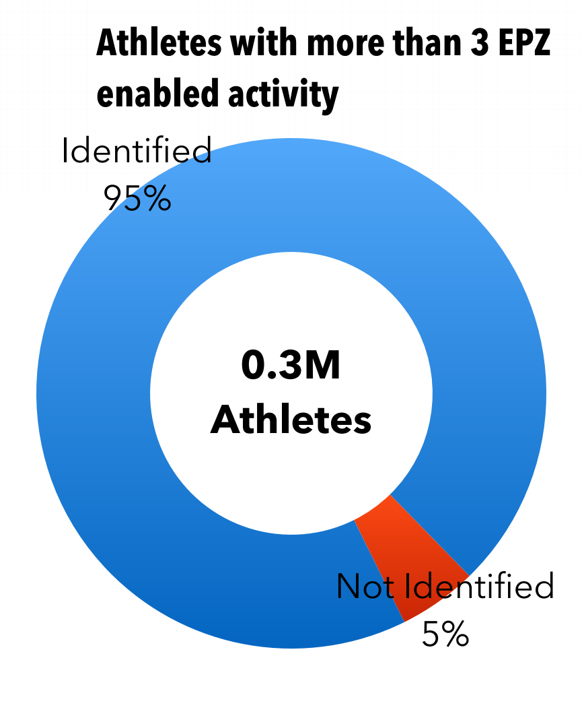
Attack Evaluation
•
After attack validation we identified actual protected location
•
Deployed our search algorithm on protected activities
21

Slide 41
Countermeasures?
22

Slide 42

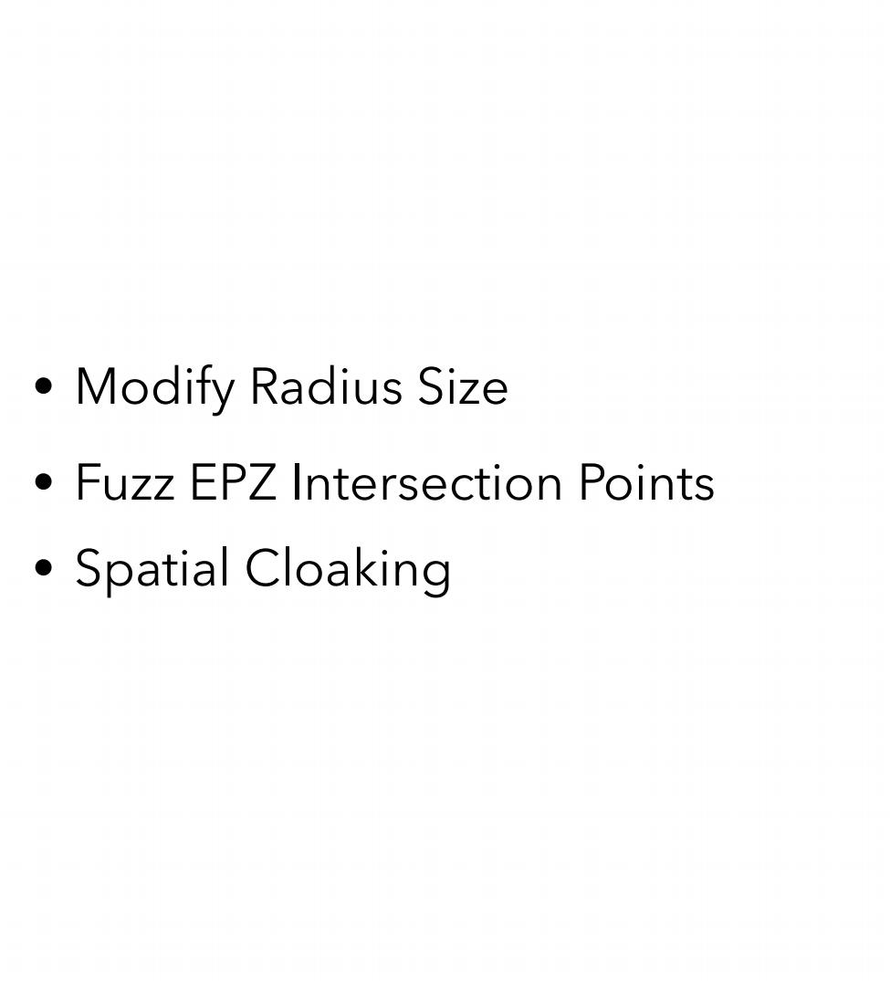
Countermeasures?
22

Slide 43



Spatial Cloaking
Adapt geo-indistinguishability in the context of fitness tracking services
23

Slide 44




Spatial Cloaking
Adapt geo-indistinguishability in the context of fitness tracking services
Shift the center of EPZ
Sensitive location can be anywhere inside new EPZ
23

Slide 45






Attack on Spatial Cloaking
Interpolates the direction of routes as they enter EPZ
Group all the intersection together that fall within certain threshold and find centroid
Prediction successful if centroid falls without 50 meters of protected location
24

Slide 46

Attack on Spatial Cloaking
Interpolates the direction of routes as they enter EPZ
Group all the intersection together that fall within certain threshold and find centroid
Prediction successful if centroid falls without 50 meters of protected location
24

Slide 47
Spatial Cloaking Results
Spatial Clocking Still Leaks Information
25

Slide 48
Spatial Cloaking Results
50
Spatial Clocking
Still Leaks Information
40
Accuracy (Percentage)
30
20
10
0
0.125
0.250 0.375
Radii of EPZs (miles)
0.50
0.625
25

Slide 49
Impact
Our defense was adopted by:
26

Slide 50

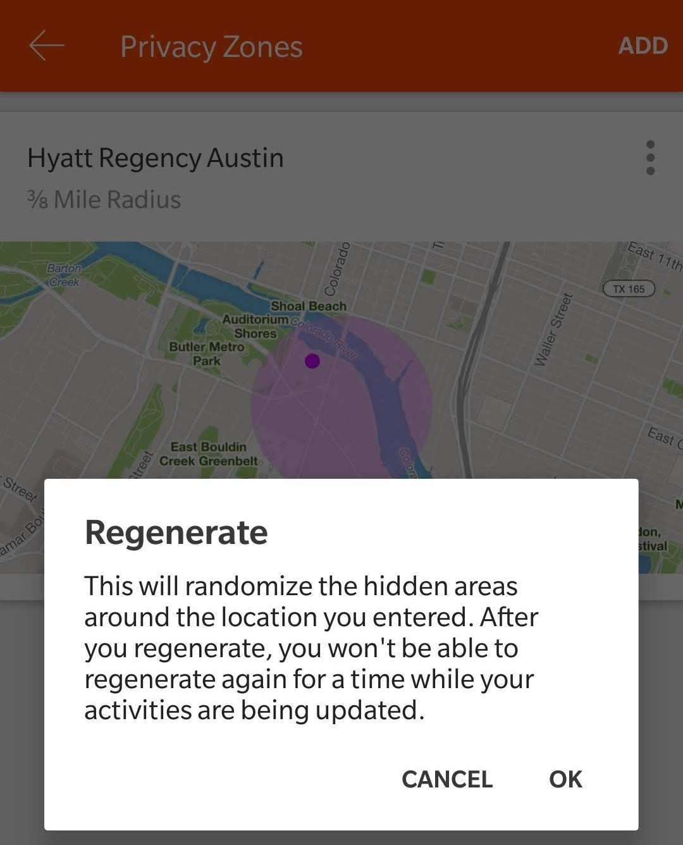

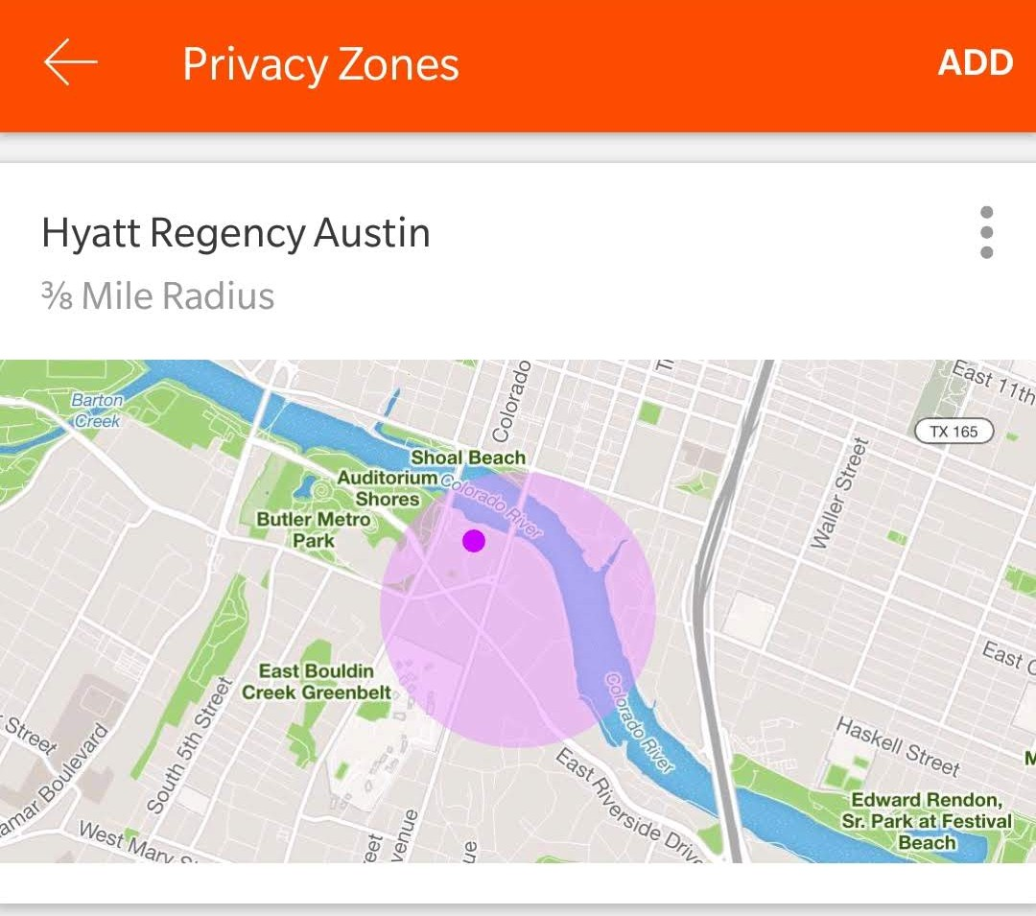


Impact
Our defense was adopted by:
26

Slide 51
Takeaways
Demonstrate that EPZ was a bad privacy measure from its infancy
Intrinsic risk between desire to publish route information while concealing sensitive endpoints.
Need efficient and usable privacy features in fitness tracking apps
27

Slide 52

Thanks & Questions
whassan3@illinois.edu
28

Slide 53
Backup Slides
29

Slide 54
Finding EPZ Activity
Through experimentation we discovered if an activity is using EPZ.
There is a discrepancy between the advertised distance on the activity page and the final distance traveled according to the GPS samples

Slide 55

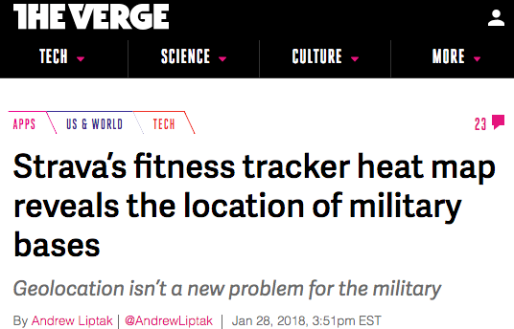
Heatmap Incident
EPZ found in our dataset:
1 of 7 athletes at GCHQ
1 of 8 athletes at Pine Gap
1 of 13 athletes at Kandahar

